Slide 1
System Design Tricks for
Low-Power Video Processing
Jonah Probell, Director of Multimedia Solutions, ARC International

Slide 2
About Jonah Probell
Author of VideoBits.ORG
Digital video expert
Processor architect
Semiconductor IP developer
Entrepreneur
Consultant
Solutions architect for ARC International

Slide 3
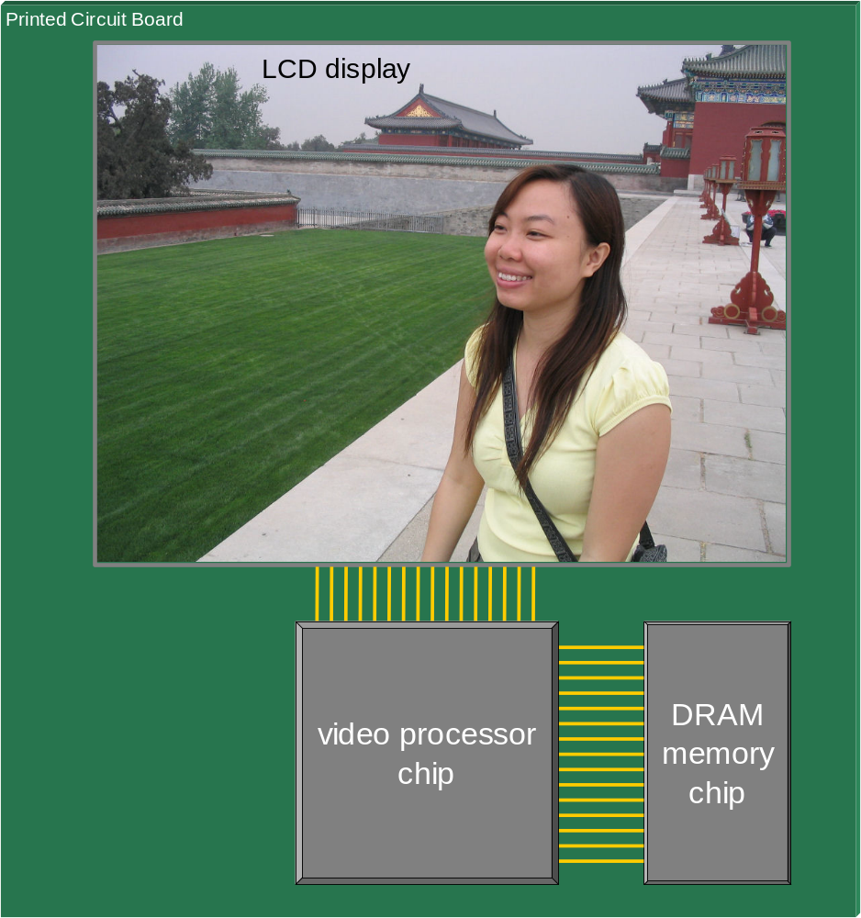
Consumer Video Device Diagram

Slide 4
Tricks
Sleep mode
Image enhancement
SRAM vs SDRAM
Data bus width
System in package
Frame buffer tiling

Slide 5
Presentation Format
Basis
Action
Cost

Slide 6
Trick: Sleep mode
The worst frame cycle count often exceeds the average by 2x or more.
Run the clock fast enough to process the worst frame without dropping frames. Most frames finish early. For these, enter a power saving sleep mode until it is time to process the next frame.
Chip design complexity due to clock gating and multiple voltage islands.

Slide 7
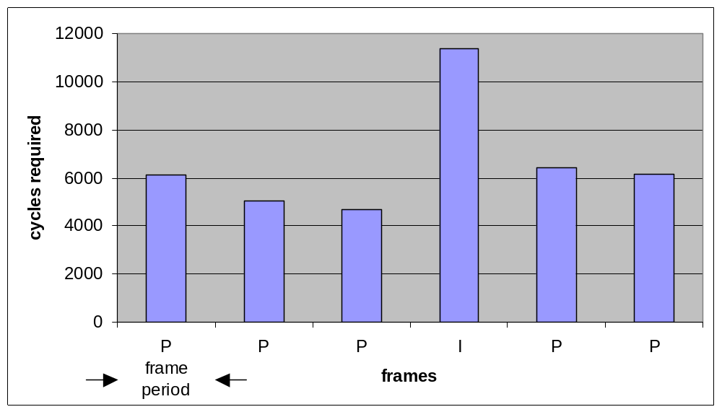

Example frame processing
CPU work / sleep time

Slide 8
Trick: Image enhancement
LCD display illumination is the largest consumer of power in most mobile video devices. A sharper, brighter, higher contrast image can be discerned with less illumination.
Digitally enhance the brightness, contrast, and edge sharpness of the image in the CPU and dim the display illumination to save power.
CPU power consumption is increased to perform the extra calculations.

Slide 9

Example original image

Slide 10

Example enhanced image

Slide 11
Trick: SRAM vs SDRAM
Off-chip memory access bandwidth can be reduced by increasing on-chip memory.
Increase on-chip cache and buffer SRAMs to decrease off-chip SDRAM accesses.
Processor chip size increases.

Slide 12
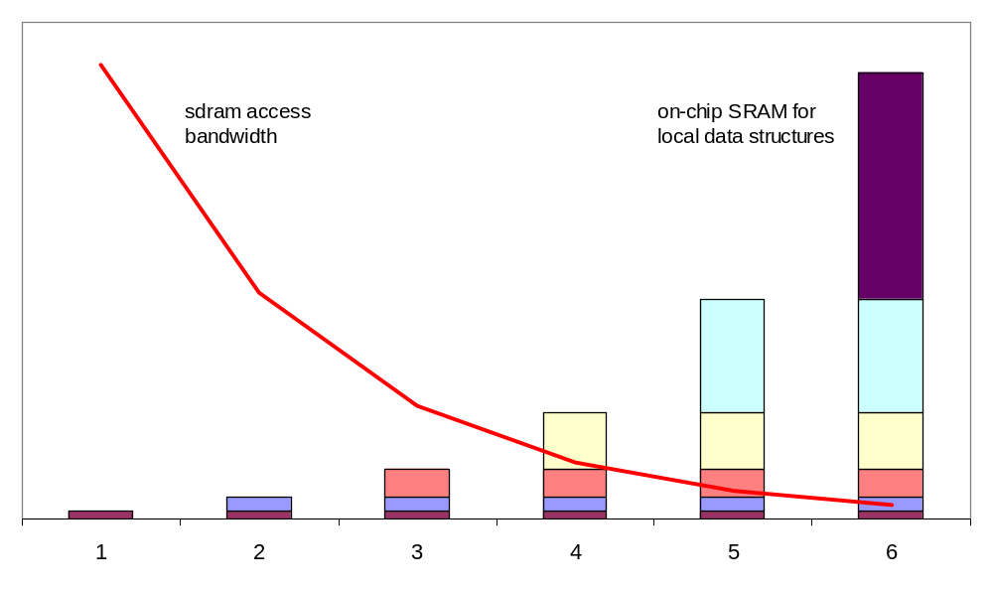
SRAM vs SDRAM example

Slide 13
Trick: Data bus width
A significant component of SDRAM power consumption is proportional to the number of data transfer cycles.
Increase data bus width to decrease transfer cycles.
Increased pin count and pad ring die area.

Slide 14
Data transfer power at different bus widths
DRAM
Bank
Array
DRAM
Bank
Array
DRAM
Bank
Array
32-bit wide DRAM→
DRAM
Bank
Array
X32 bits
DRAM
Bank
Array
DRAM
Bank
Array
DRAM
Bank
Array
sense amps
DRAM
Bank
Array
←16-bit wide DRAM
X16 bits
sense amps

Slide 15
Trick: System in package
Traces within a package are smaller and have lower capacitance than traces on a board.
Include processor chip and DRAM chip within the same package to increase speed and reduce power consumption.
Increased packaging complexity and component cost.

Slide 16
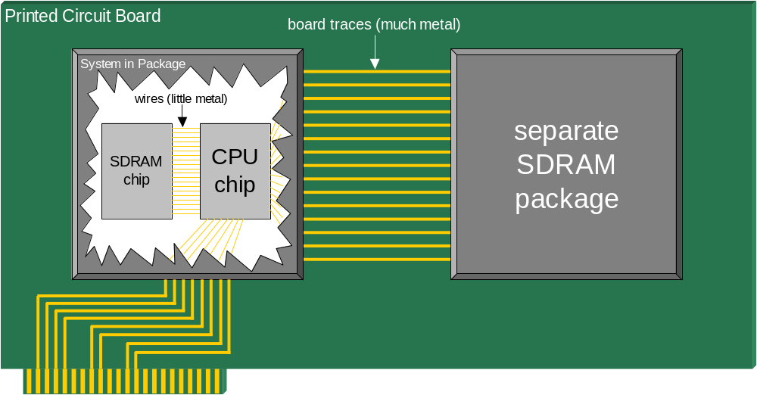
System in package diagram

Slide 17
Trick: Frame buffer tiling
A large portion of SDRAM access time for motion compensation block reads is due to row address switching (RAS) delay.
Store reference frame data ordered by rectangular tiles, rather than in raster order, to probabilistically reduce the number of SDRAM rows accessed for each prediction block read.
Rasterization step required before display.

Slide 18

Frame buffer data order
Raster scan order
Tiled order

Slide 19

Conclusion
Correct design can significantly reduce the power consumption of digital video systems.
Making optimal design trade-offs requires a software programmable, configurable, video optimized processor.
  Sleep mode – software programmable
  Image enhancement – software programmable
  SRAM vs SDRAM – configurable
  Data bus width – configurable
  System in package – configurable
  Frame buffer tiling – video optimized

